Slide 1
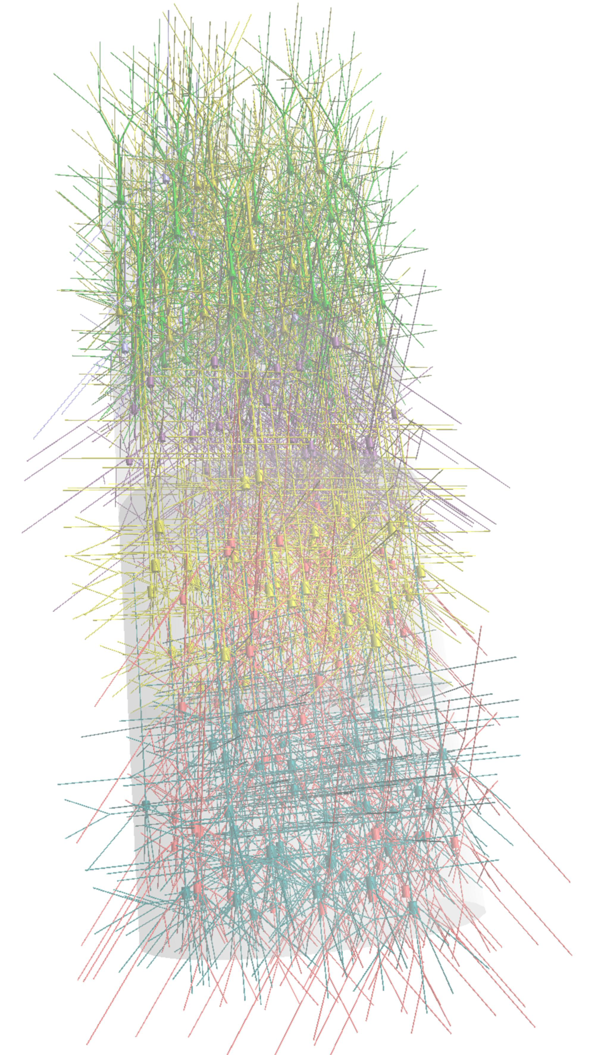
NeuroML: Reproducibility and Rigour in Computational Neuroscience
Sharon Crook
Laboratory for Informatics and Computation in Open Neuroscience
https://iconlab.asu.edu
Arizona State University
Notes:
Thank you, accommodations, etc.
Thank you to organizers for giving me a chance to talk about this topic that has become a area of
Increasing interest in the neuroinformatics community—many projects/people devoted to efforts to create an infrastructure for reproducibility in comp neuro.

Slide 2
Reproducibility and Rigour
Notes:
Thank you, accommodations, etc.
Thank you to organizers for giving me a chance to talk about this topic that has become a area of
Increasing interest in the neuroinformatics community—many projects/people devoted to efforts to create an infrastructure for reproducibility in comp neuro.

Slide 3
Reproducibility and Rigour
Accessibility
Portability
Transparency
Notes:
Thank you, accommodations, etc.
Thank you to organizers for giving me a chance to talk about this topic that has become a area of
Increasing interest in the neuroinformatics community—many projects/people devoted to efforts to create an infrastructure for reproducibility in comp neuro.

Slide 4
What is NeuroML?
http://neuroml.org
RRID:SCR_003083

Slide 5
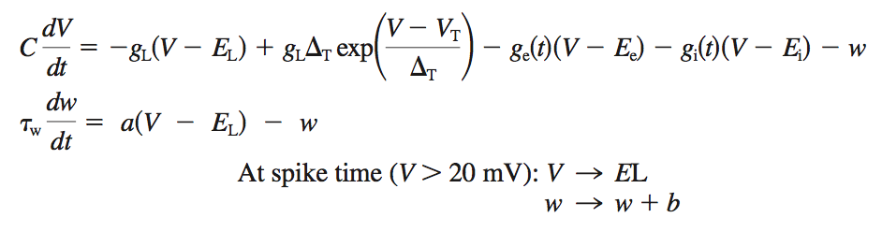
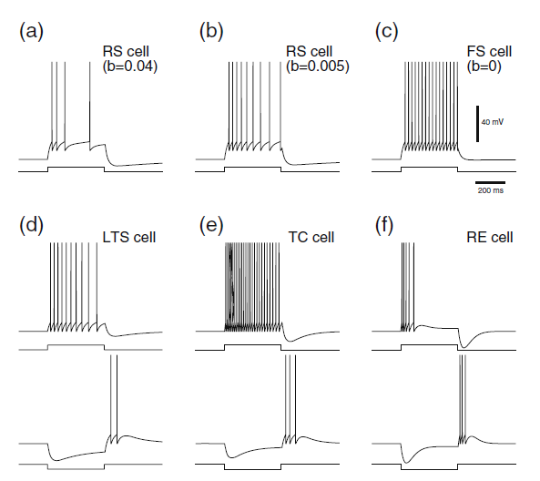
Adaptive Exponential Integrate & Fire Model
(Brette and Gerstner)

Slide 6
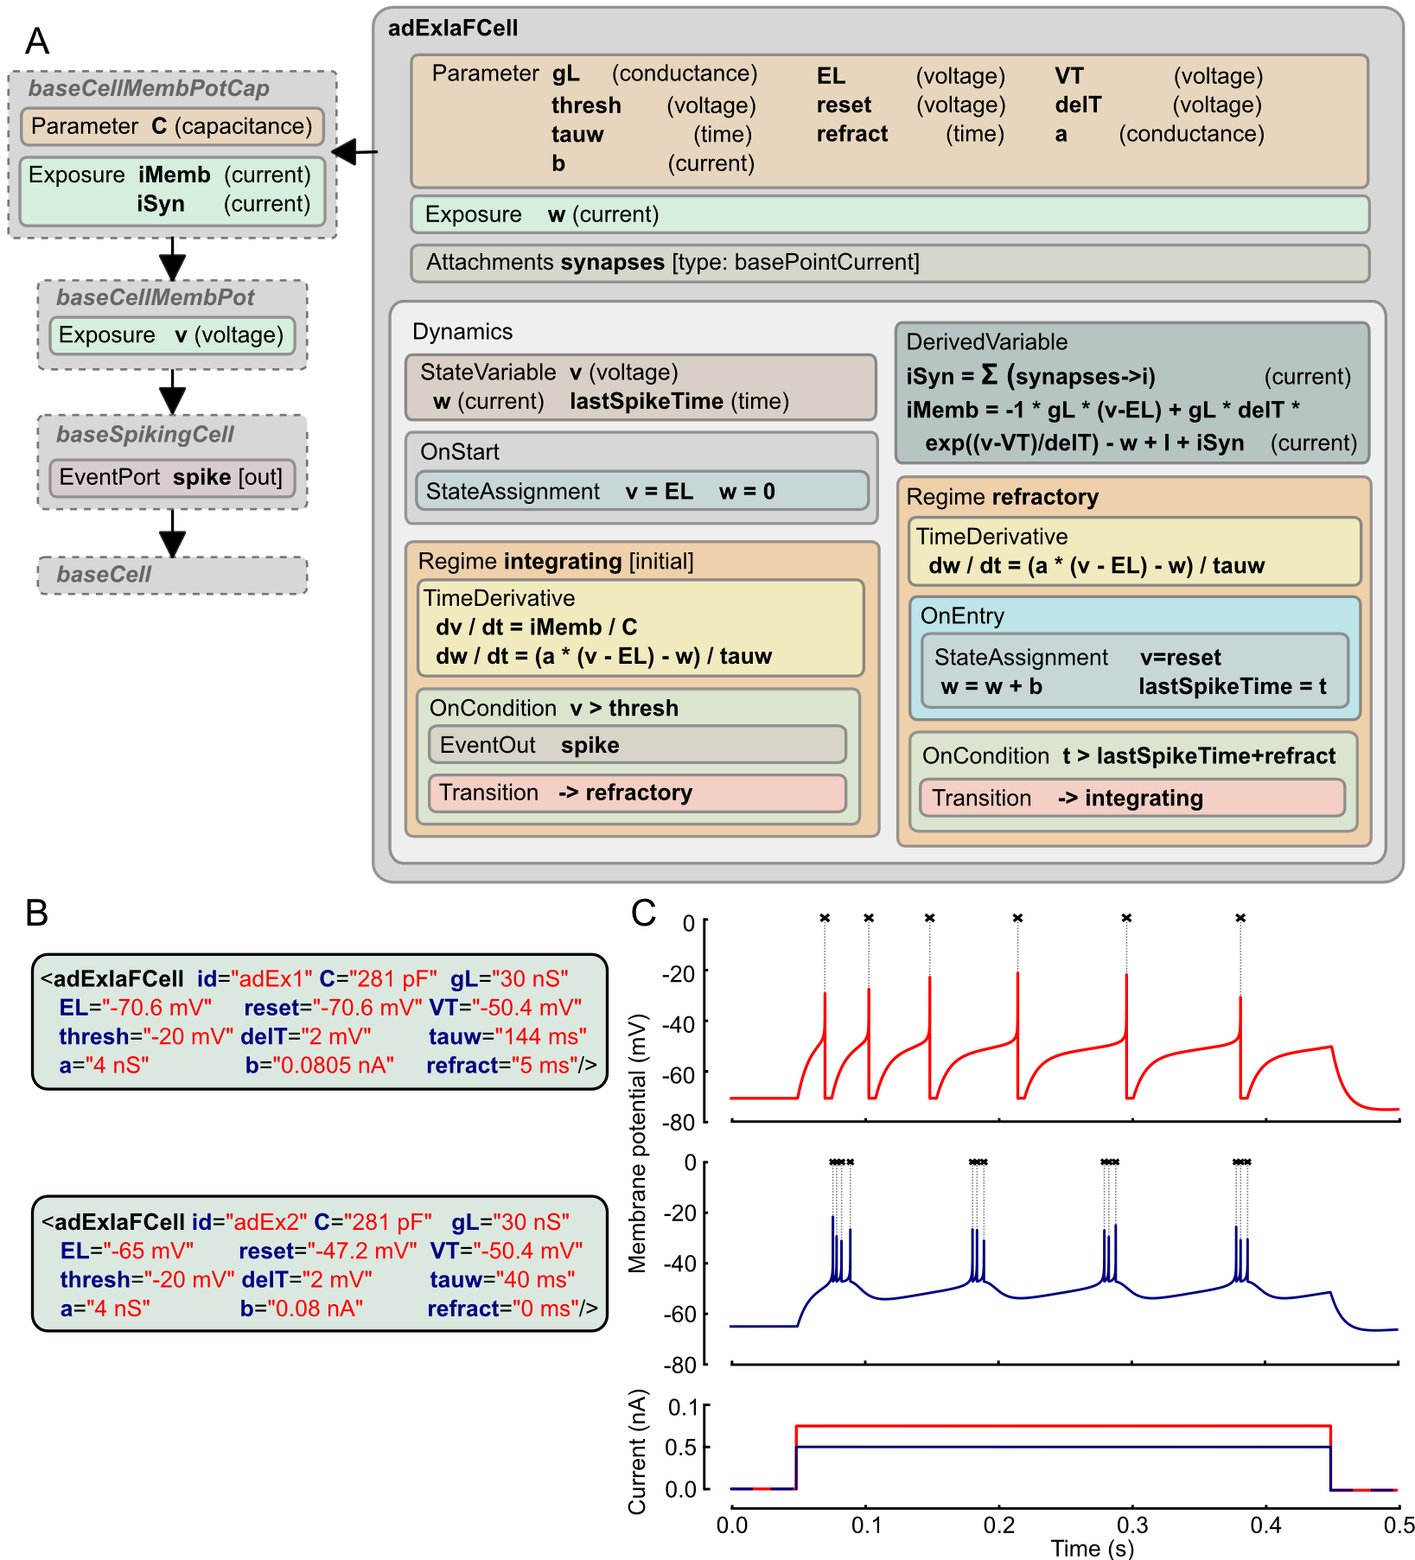
NeuroML 2

Slide 7
LEMS
NeuroML 2

Slide 8
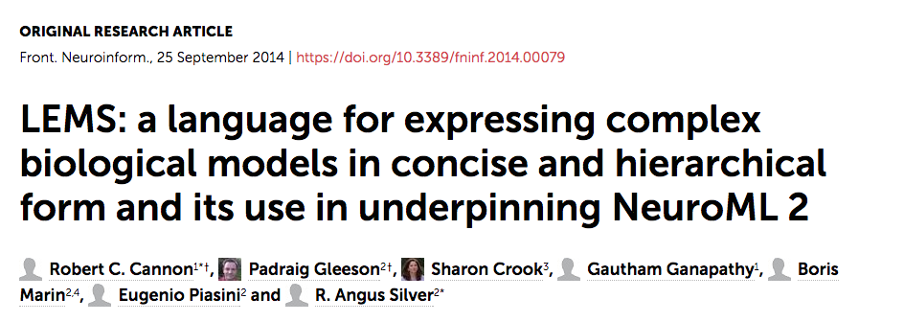

Slide 9
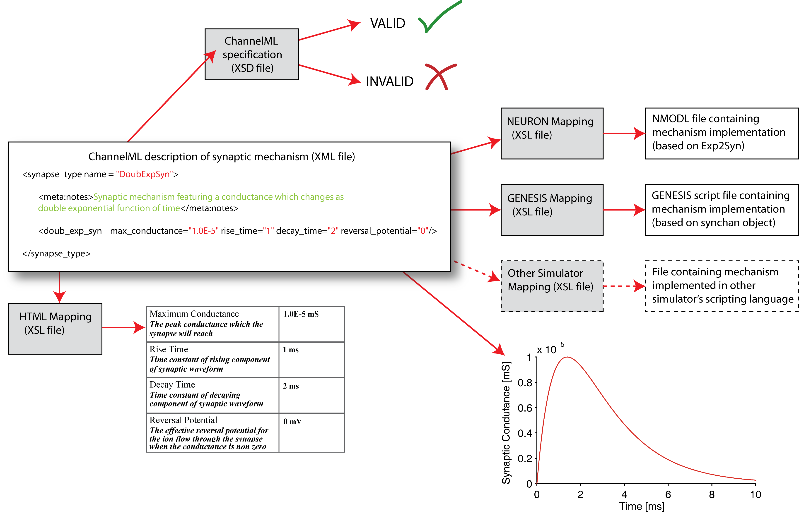
NeuroML Synaptic Conductance Example

Slide 10
Tools for Working Directly with NeuroML Documents

Slide 11
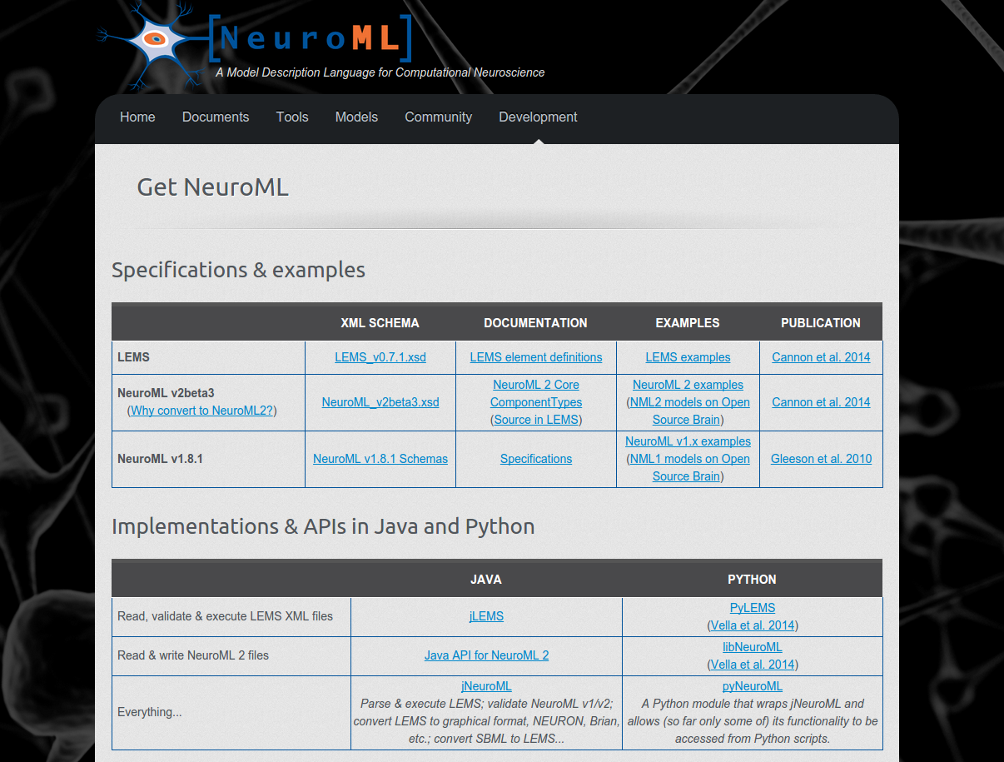
http://www.neuroml.org/getneuroml
Brian
MATLAB
NEURON
http://www.opensourcebrain.org
Notes:
10/27/17
11
11

Slide 12
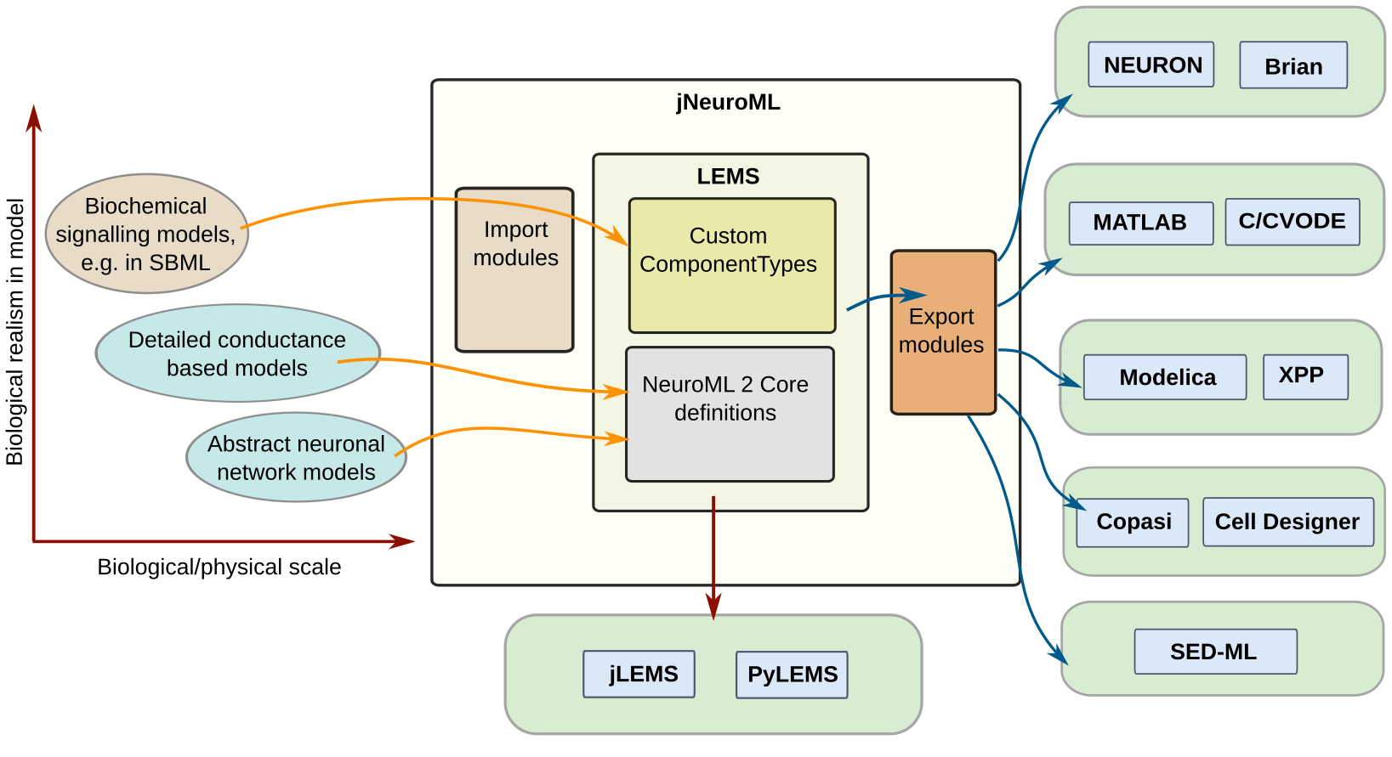
Notes:
10/27/17
12
12

Slide 13
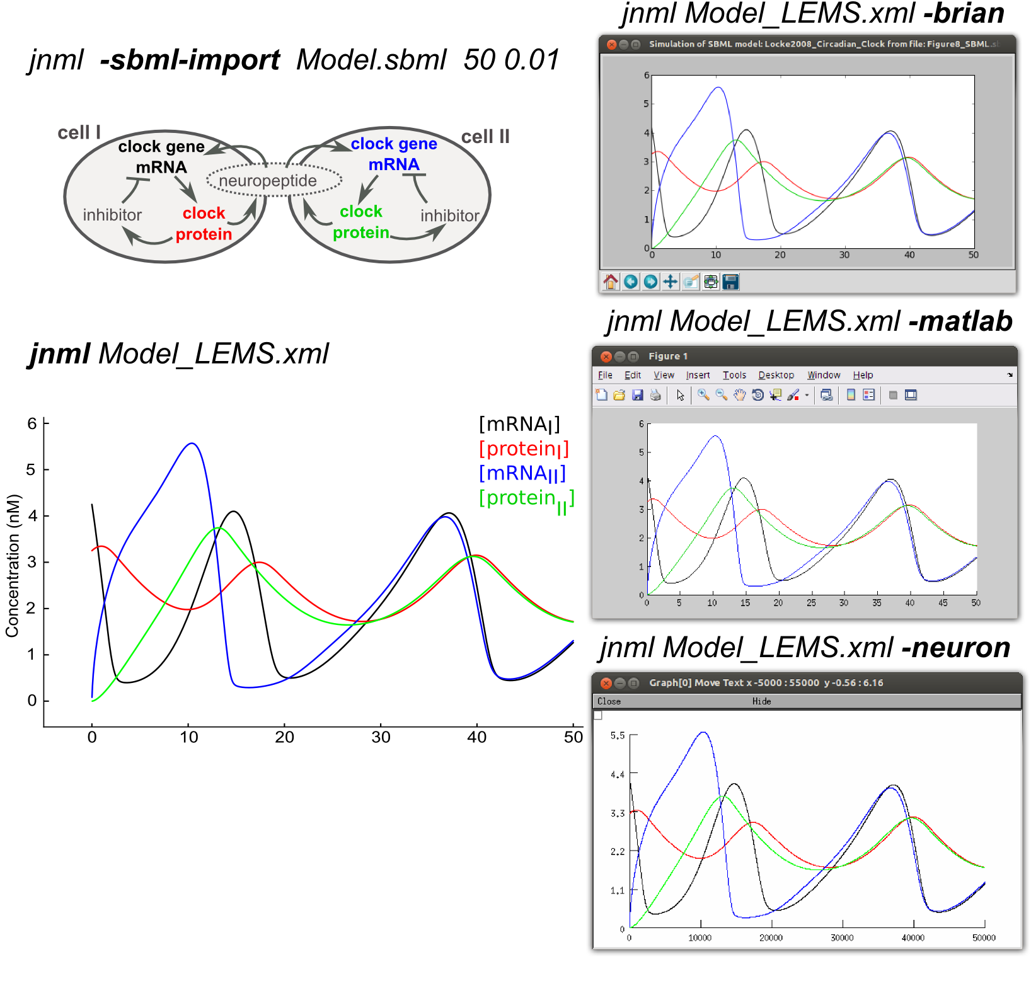
Original
SBML
model
Brian
MATLAB
Simulate
with
jNeuroML
NEURON
SBML Showcase at Open Source Brain
Notes:
10/27/17
13
13

Slide 14
Other Tools and Projects with
NeuroML Support
http://neuroml.org/tool-support
RRID:SCR_012844

Slide 15
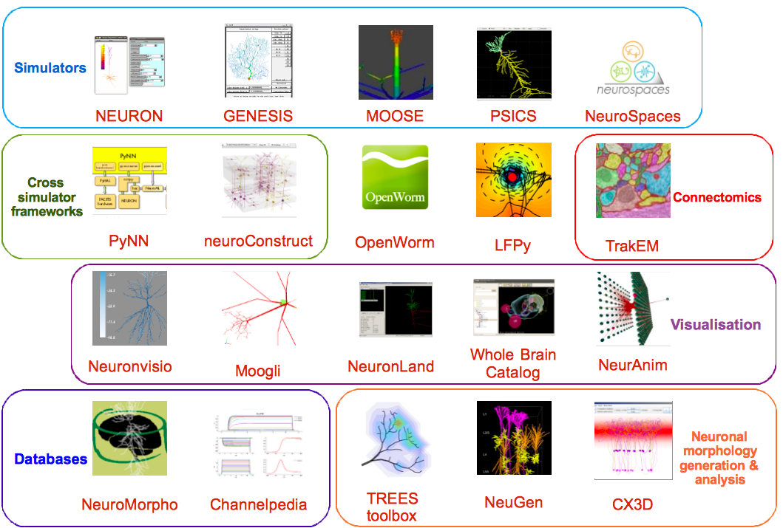

Slide 16
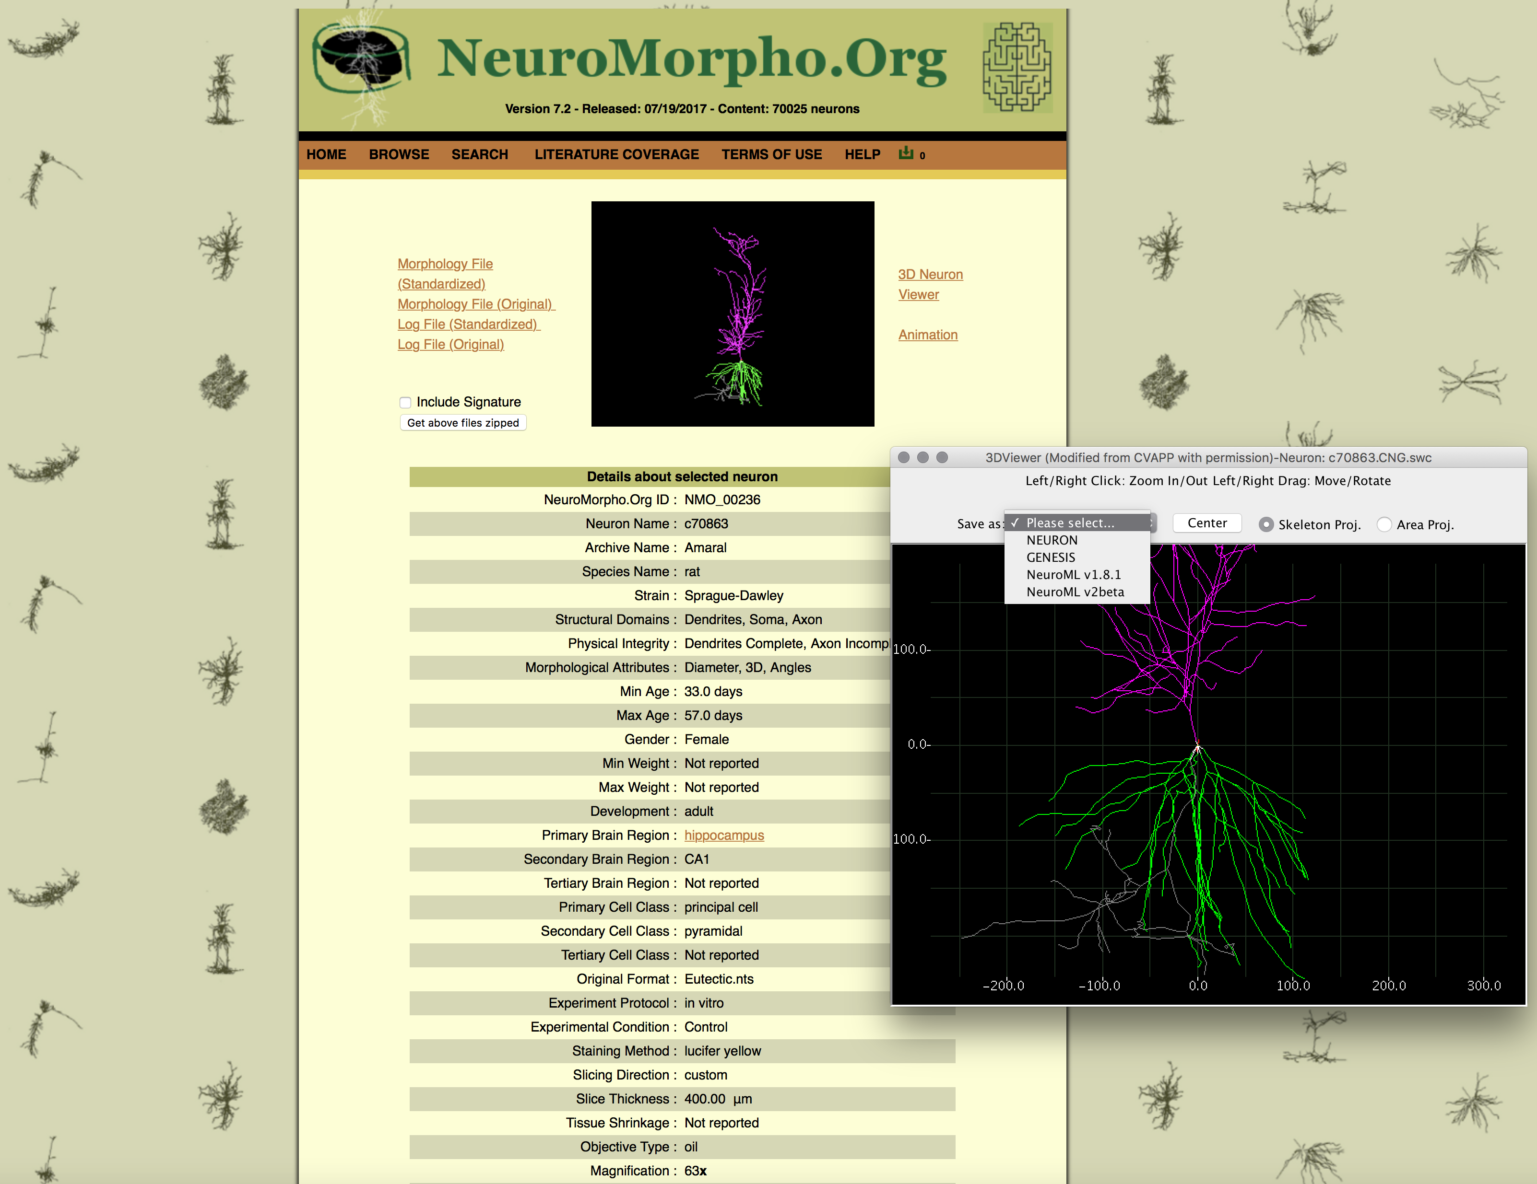
http://neuromorpho.org
RRID:SCR_002145
Notes:
GIORGIO ASCOLI

Slide 17
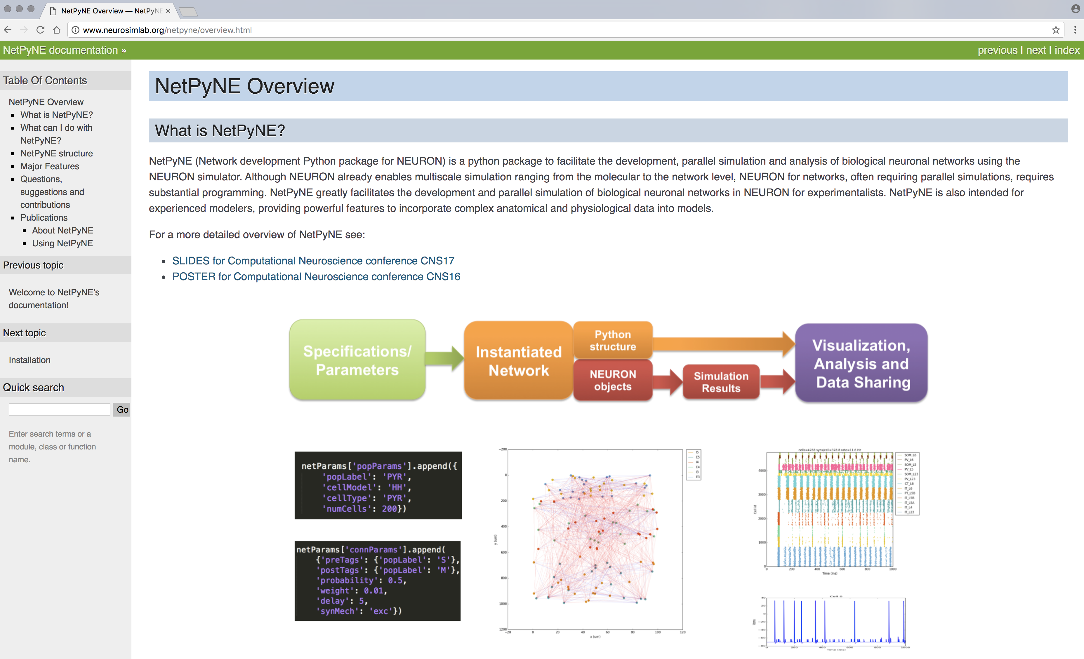
http://neurosimlab.org/netpyne
RRID:SCR_014758
Notes:
Bill Lytton’s neurosim lab
Developed by Salvador Dura-Bernal

Slide 18
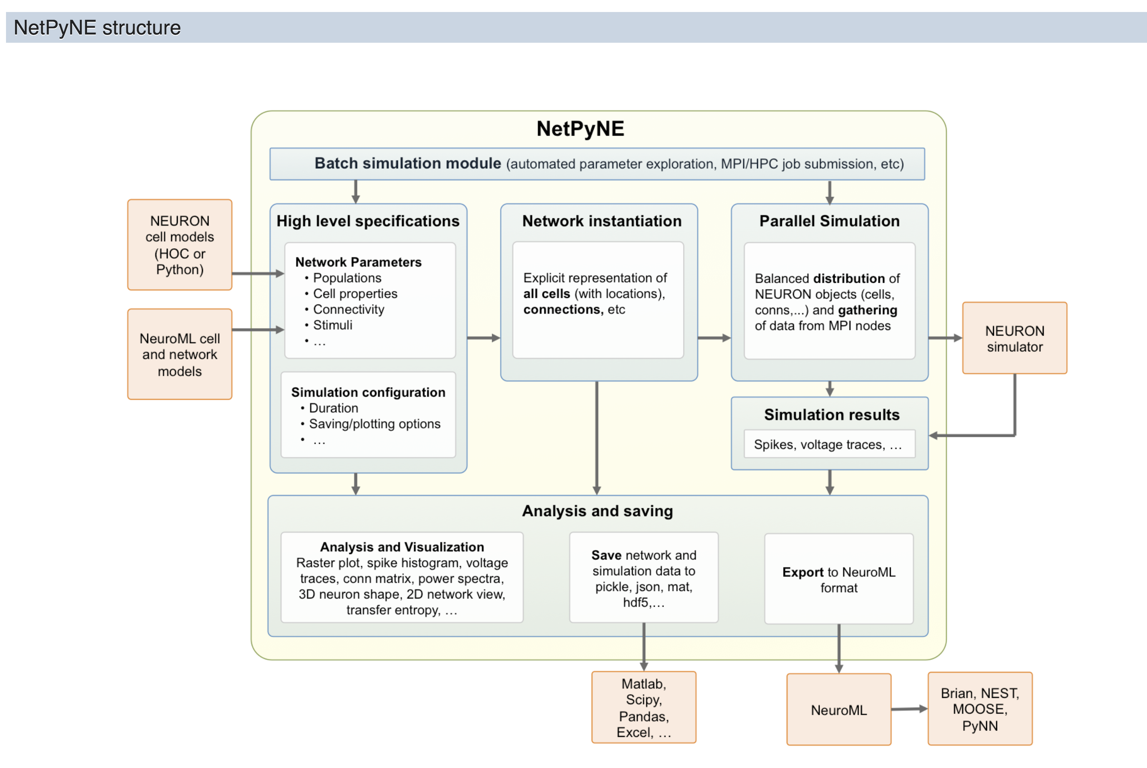

Slide 19
Model Reproducibility
and Re-use

Slide 20
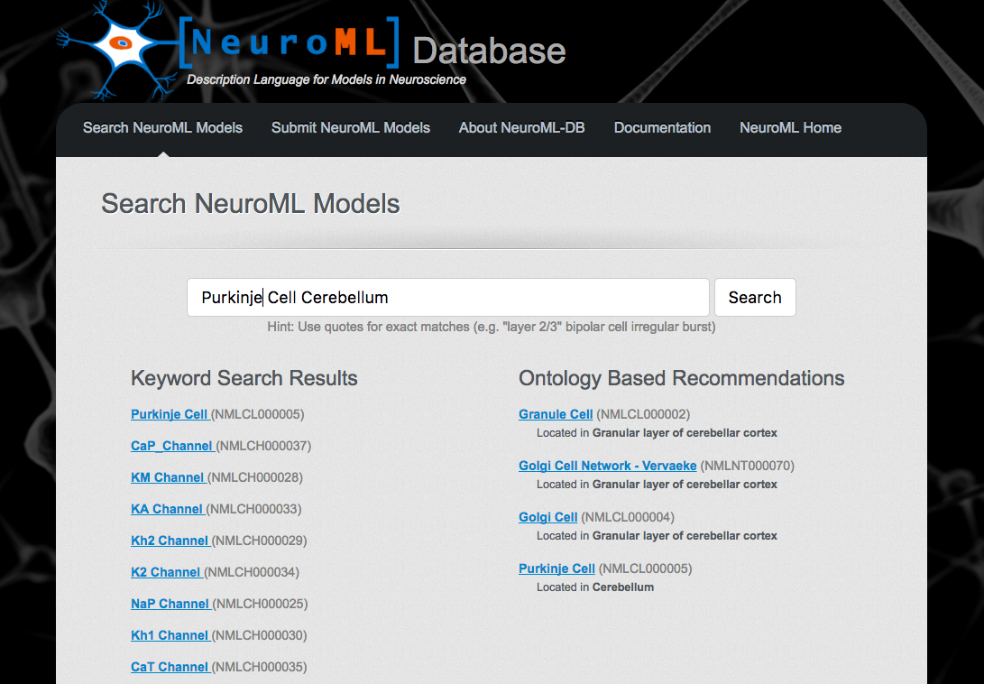
http://neuroml-db.org
RRID:SCR_013705

Slide 21
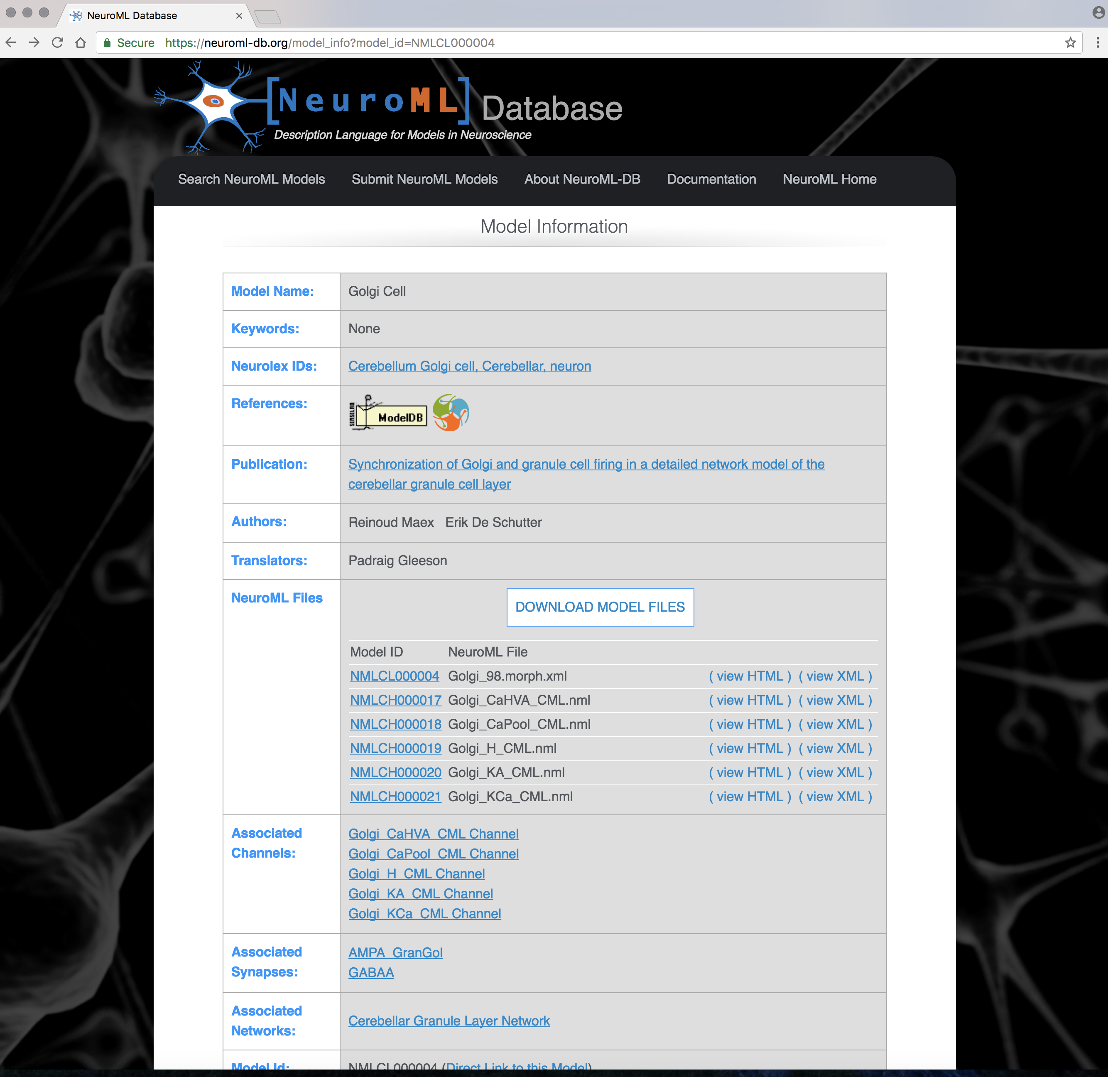

Slide 22
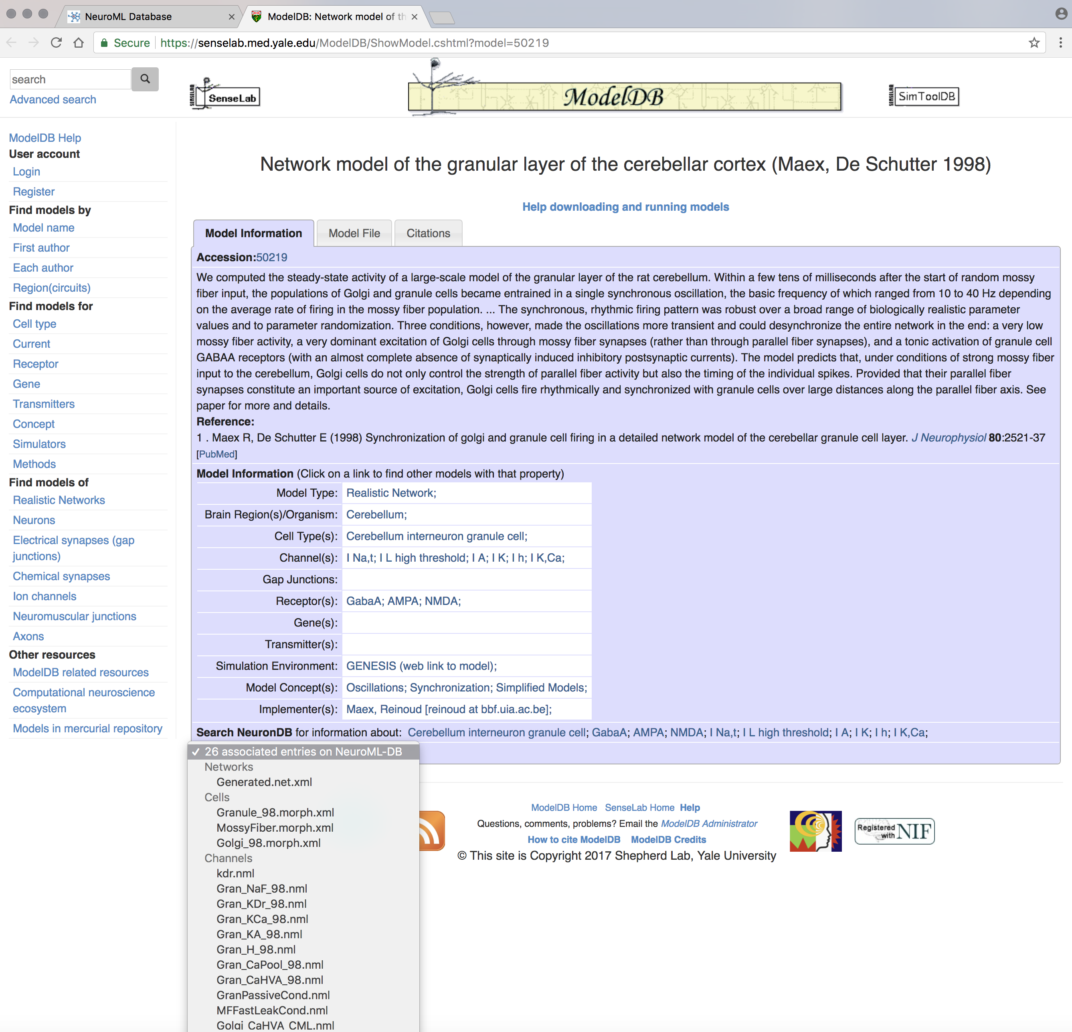
http://senselab.med.yale.edu/ModelDB
RRID:SCR_007271

Slide 23
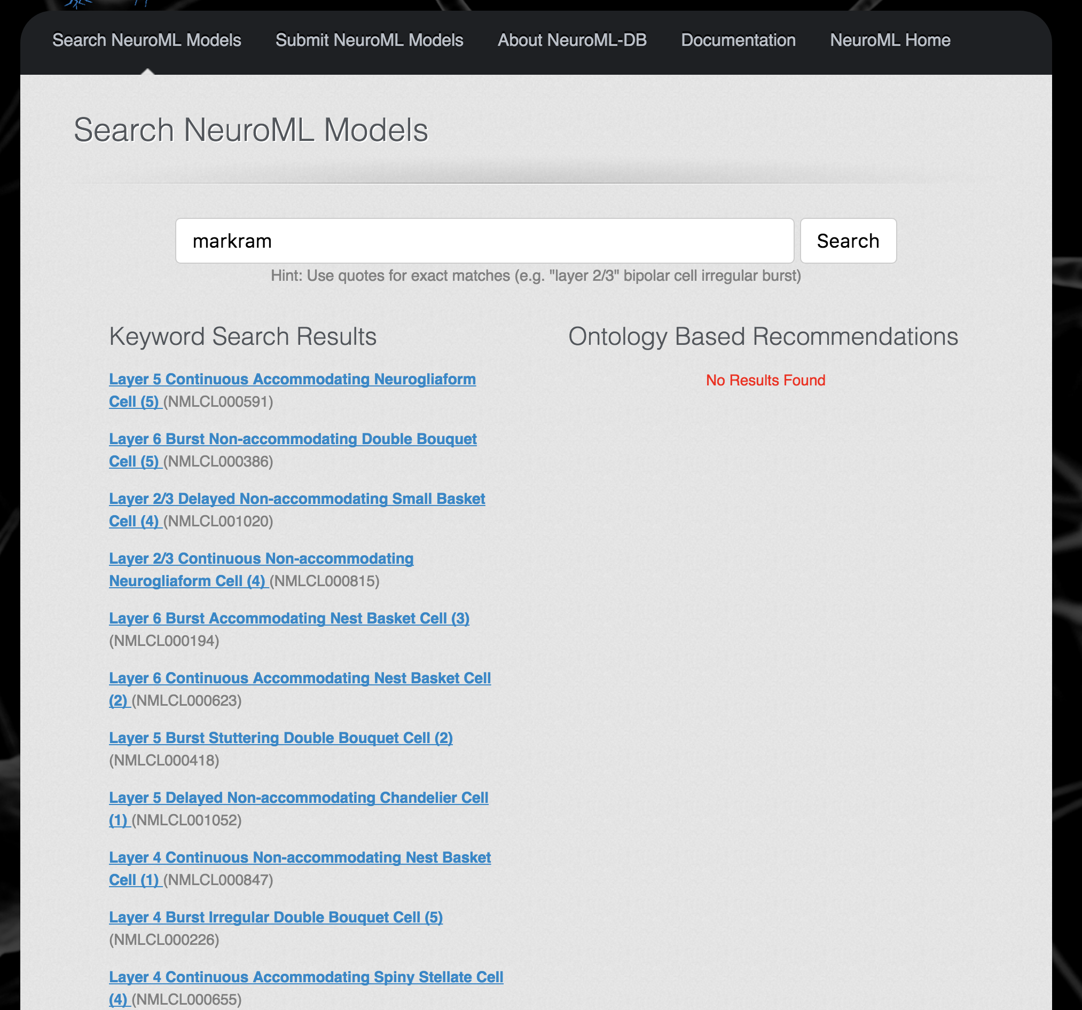
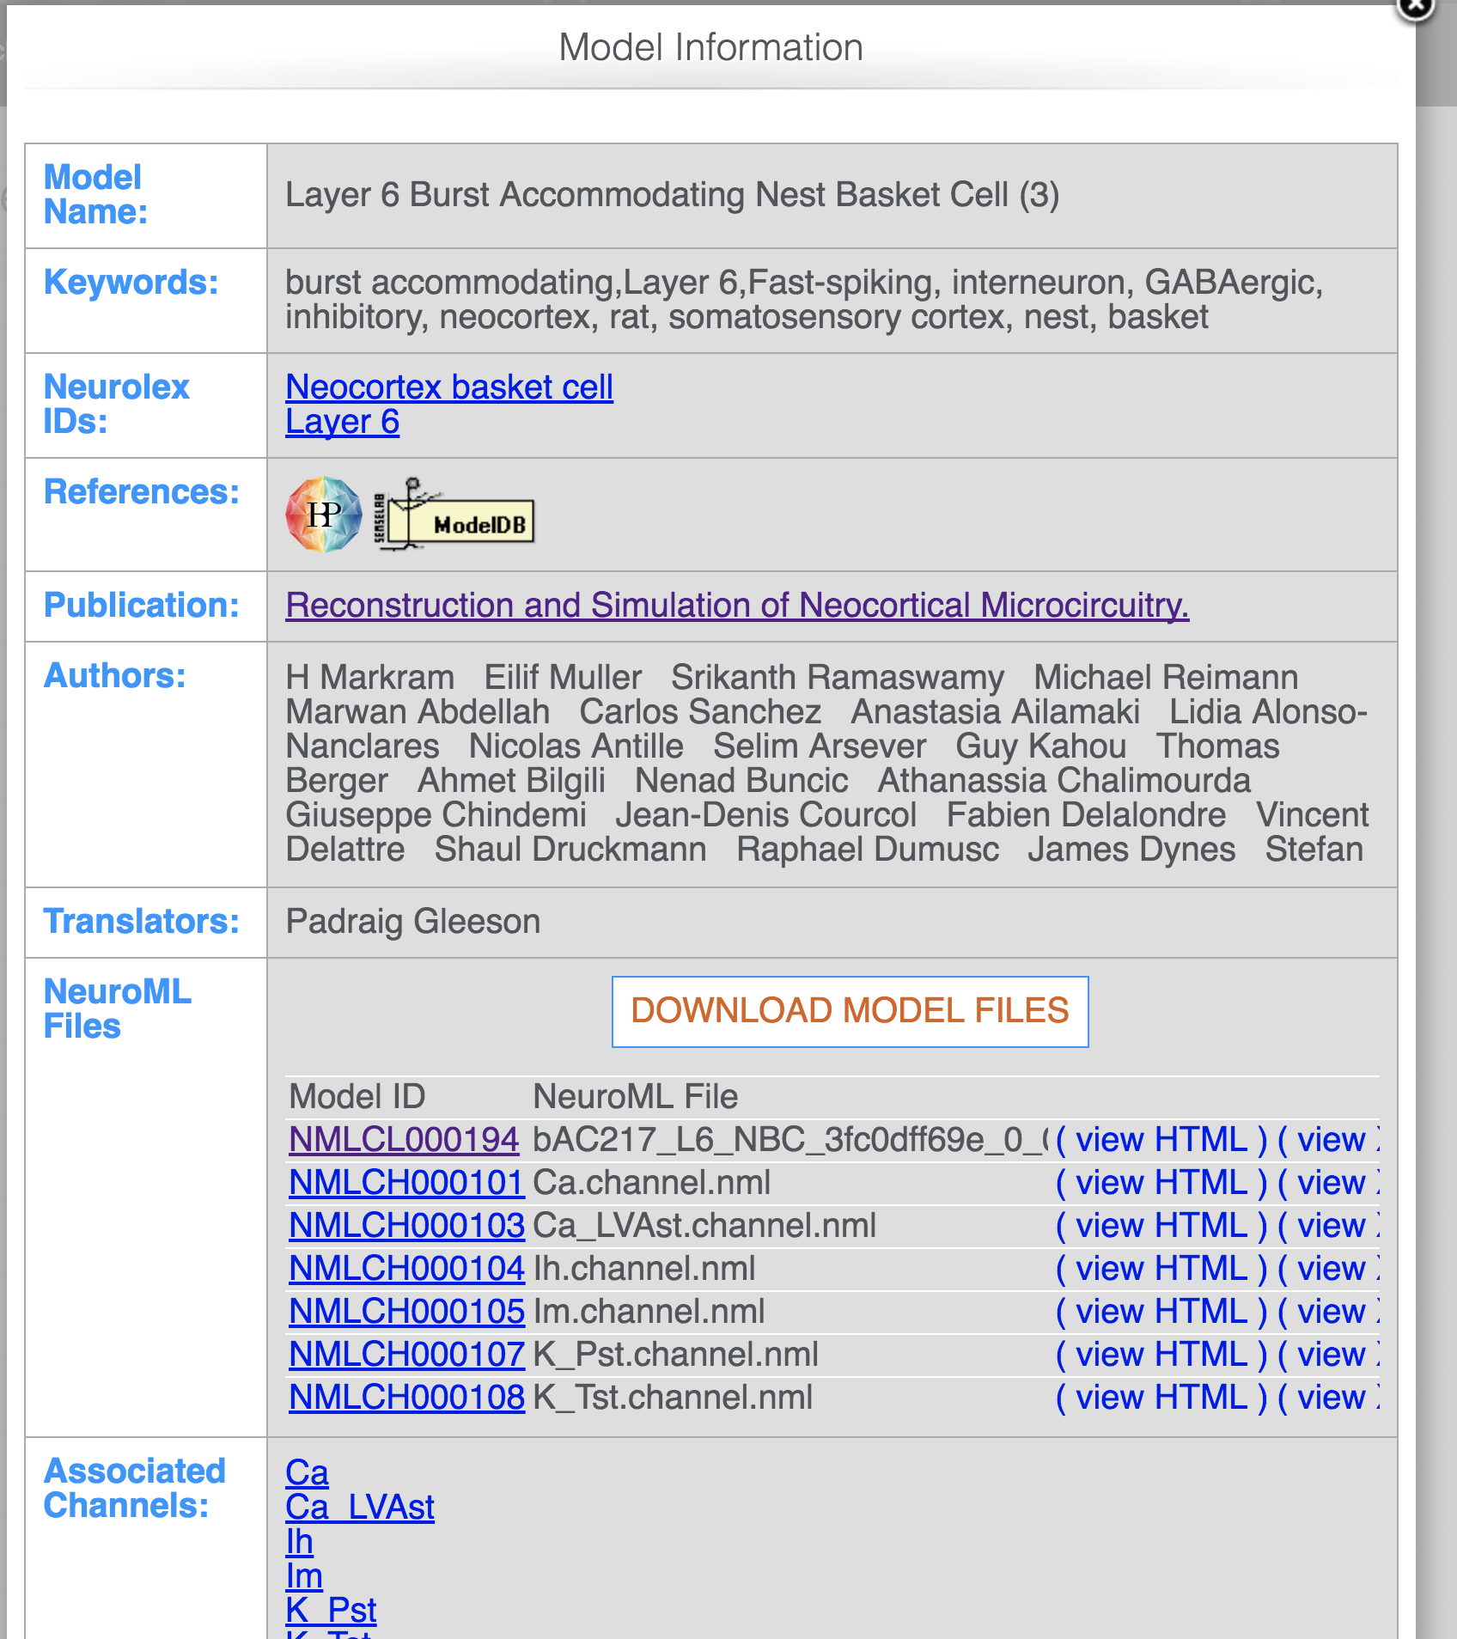
Notes:
Cell paper for large network model from blue brain project

Slide 24
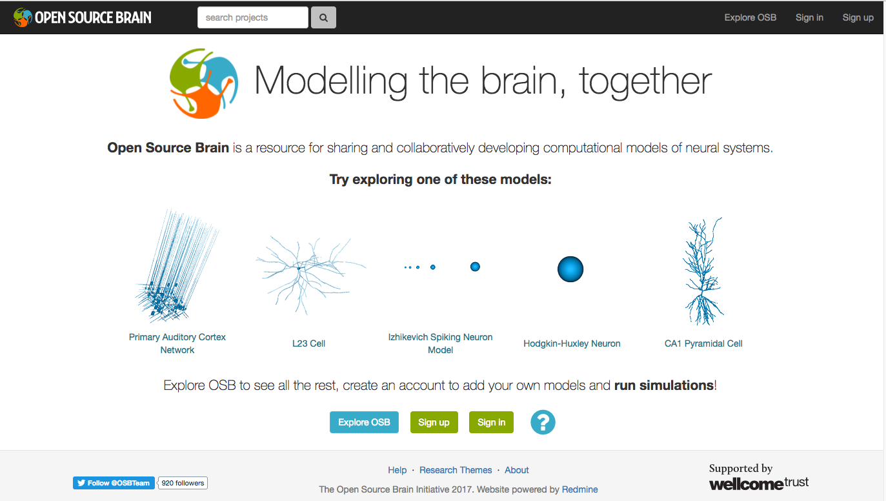
Collaborative Modeling with NeuroML at Open Source Brain
http://opensourcebrain.org
RRID:SCR_001393
Notes:
SILVER LAB

Slide 25
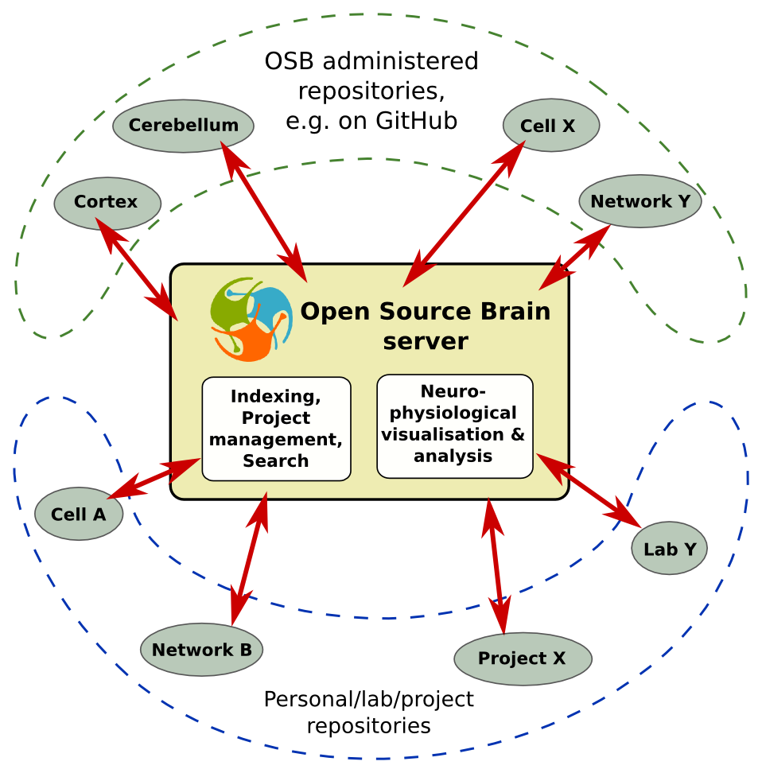


Slide 26
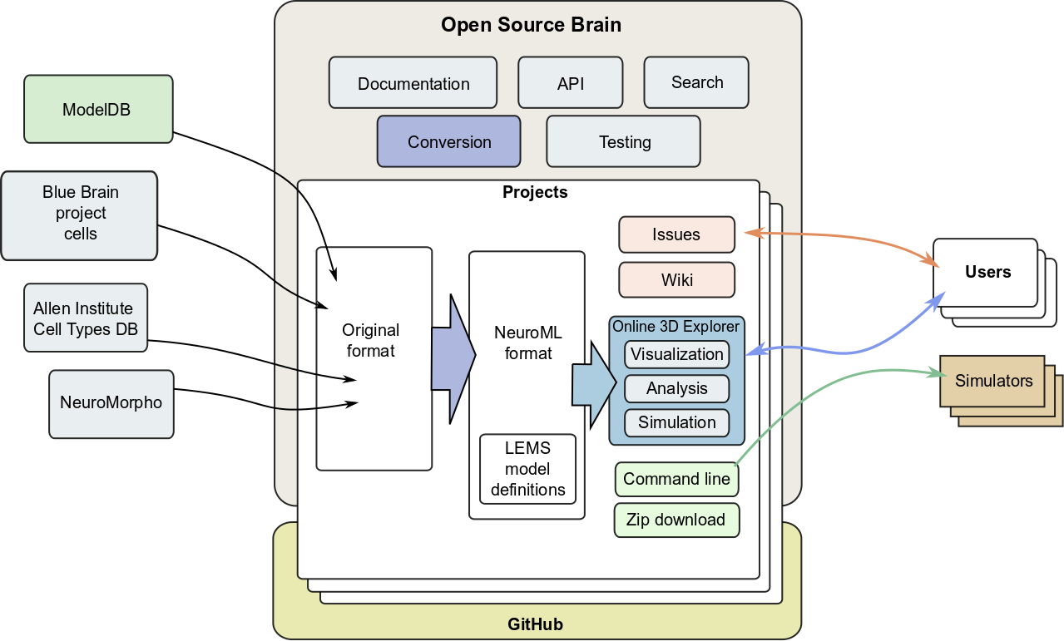
OSB features
Notes:
10/27/17
26
26

Slide 27
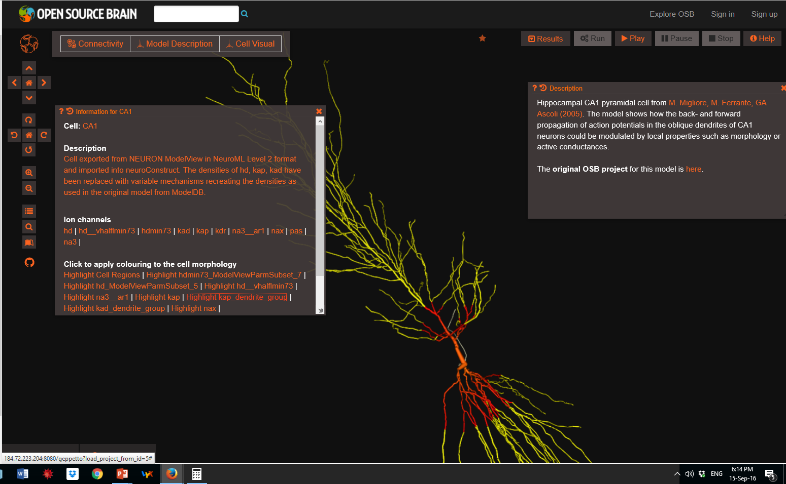
Notes:
27

Slide 28
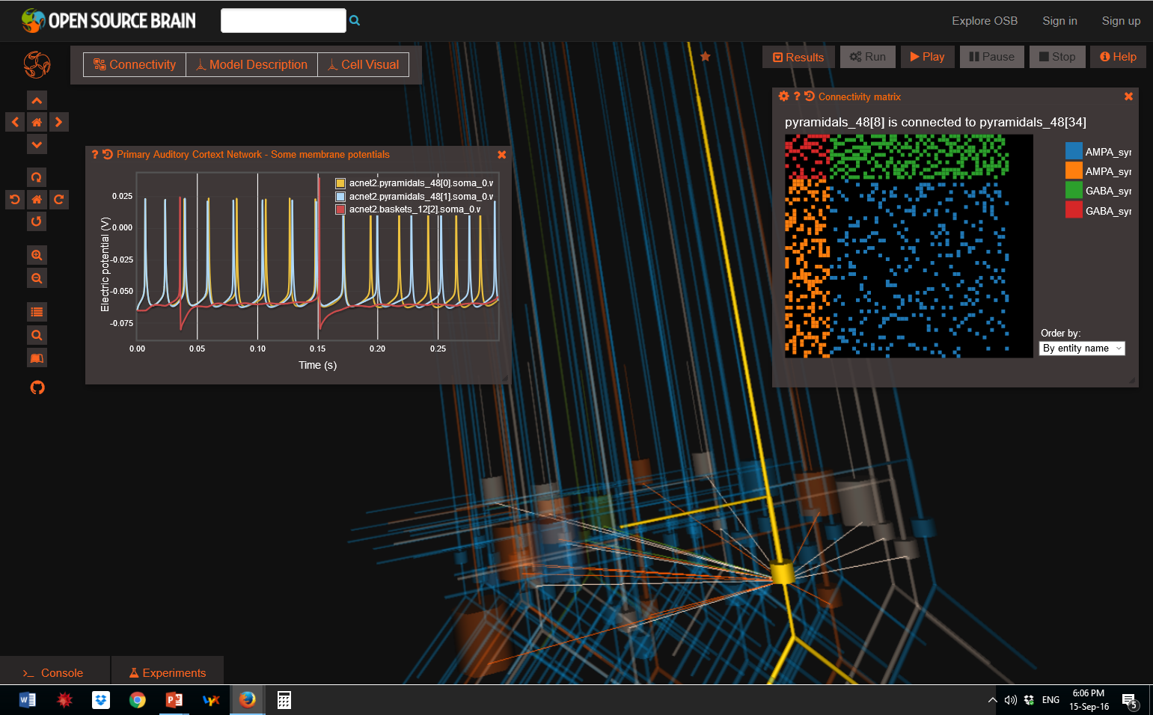
Notes:
28
It is possible to simulate models at the Neuroscience Gateway Portal supercomputer, get the results, and analyze and visualize them at Open Source Brain.

Slide 29
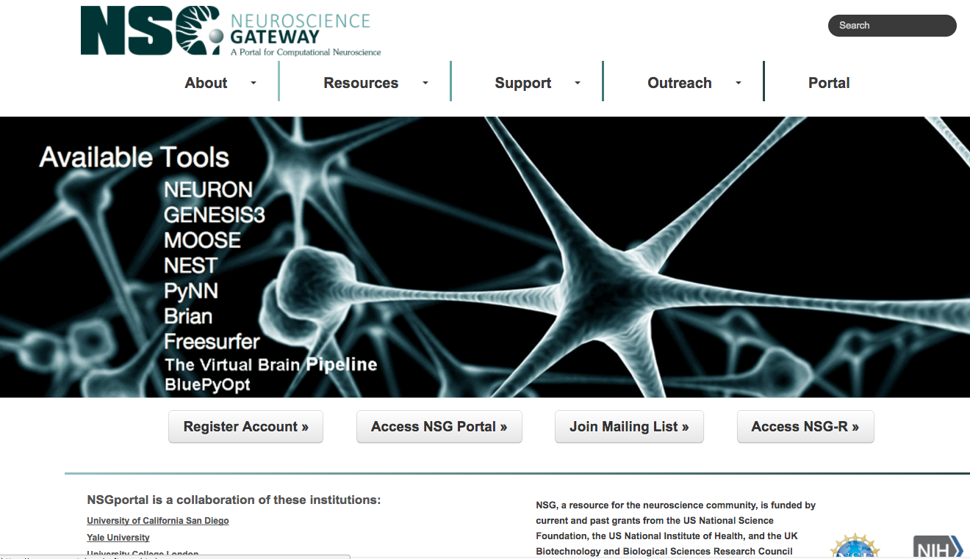
Send NetPyNE NeuroML models to run in parallel at NSG-R. Download results then analyze and visualize at Open Source Brain.
http://nsgportal.org
RRID:SCR_008915

Slide 30
Rigorous Validation of Models with NeuroML

Slide 31


Based on Idea of Unit Testing
 | Test 1 | Test 2 | Test 3 | Test 4 | Overall
App
Notes:
A partial solution to the problem might be solved by borrowing the “Unit Testing” idea from the Software Engineering discipline. In unit testing, a piece of code, an App, is considered to be working if it passes a set of automated tests that test important aspects of the code, e.g. does clicking a button send an email to the user, do the records get placed in the database, does the warehouse get a notification, etc…. If all the tests pass, the piece of code is considered to be working. If one or more fail, the code does not work.
We adapt this concept to scientific models by extending it in the following ways: 1) we don’t test Apps, we test pieces of code that implement scientific, neuroscience, models. 2) Our tests consist of deviations of the model’s prediction to the values observed experimentally that become continuous values – test scores 3) We execute the same set of tests against several models, combine the test scores, and sort the models by their overall score. The models with the lowest overall score have the smallest deviation from the experimental observations, and are considered “the best” models.

Slide 32
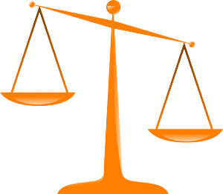
 | Test 1 | Test 2 | Test 3 | Test 4 | Overall
Model 1 | 0.1 | -0.1 | 2.0 | -0.3 | 0.6
Model 2 | 0.7 | 1.0 | -0.1 | -0.3 | 0.5
Model 3 | 0.3 | 0.3 | -0.4 | -0.3 | 0.3
Model 4 | 0.0 | 0.1 | -0.1 | -0.3 | 0.1
Model 5 | -1.5 | 2.9 | -2.4 | -0.2 | 1.8
Overall | 0.5 | 0.9 | 1.0 | 0.3
Model
Prediction
Experimental
Observation
Model Test =
Notes:
A partial solution to the problem might be solved by borrowing the “Unit Testing” idea from the Software Engineering discipline. In unit testing, a piece of code, an App, is considered to be working if it passes a set of automated tests that test important aspects of the code, e.g. does clicking a button send an email to the user, do the records get placed in the database, does the warehouse get a notification, etc…. If all the tests pass, the piece of code is considered to be working. If one or more fail, the code does not work.
We adapt this concept to scientific models by extending it in the following ways: 1) we don’t test Apps, we test pieces of code that implement scientific, neuroscience, models. 2) Our tests consist of deviations of the model’s prediction to the values observed experimentally that become continuous values – test scores 3) We execute the same set of tests against several models, combine the test scores, and sort the models by their overall score. The models with the lowest overall score have the smallest deviation from the experimental observations, and are considered “the best” models.

Slide 33
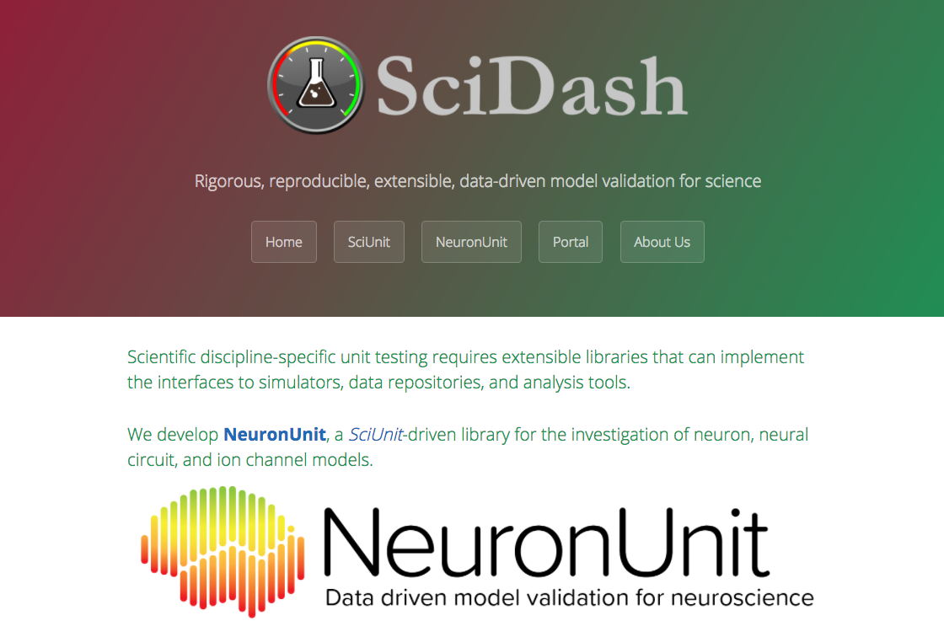
http://neuronunit.scidash.org
RRID:SCR_015634
Notes:
RICK GERKIN

Slide 34
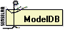
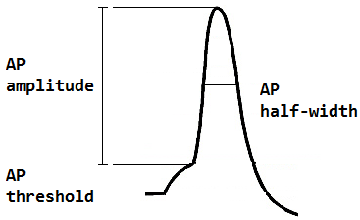
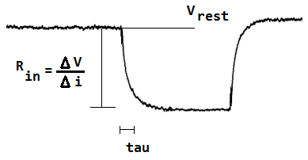
8 NEURON models of mitral cells
Deterministic, spiking models
Single and multi-compartment models
Simulation protocols run to reveal membrane and action potential properties

Slide 35
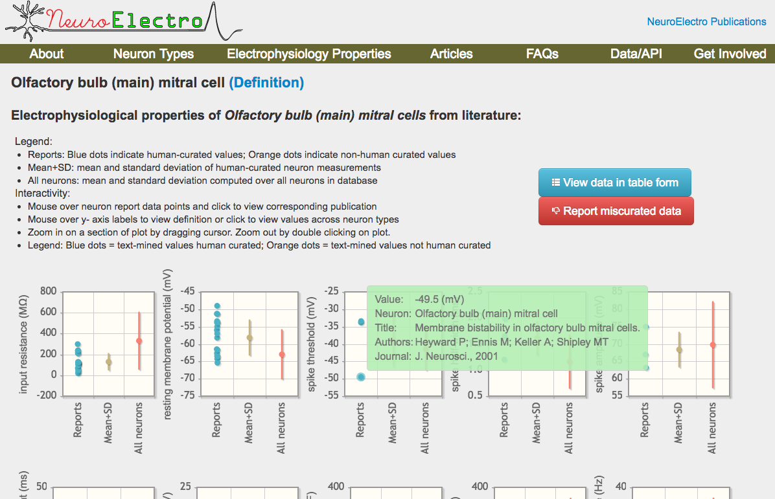
http://neuroelectro.org
RRID:SCR_006274

Slide 36
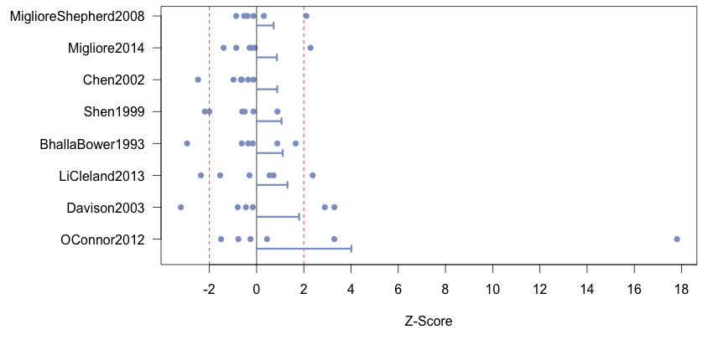
Overall Model Deviations
Expected >2 SD: 2.4
Actual: 12
p < 0.001 **
Notes:
Blue dots are the properties, lines are average model deviations (absolute). Y axis is sorted by average model deviation. Most properties of all models are within 2SDs from experimental means. All models have at least one property outside the 2SD window. Bars give average of absolute value of z scores.
!!! Not neccesarily biophyz realistic models !!!

Slide 37
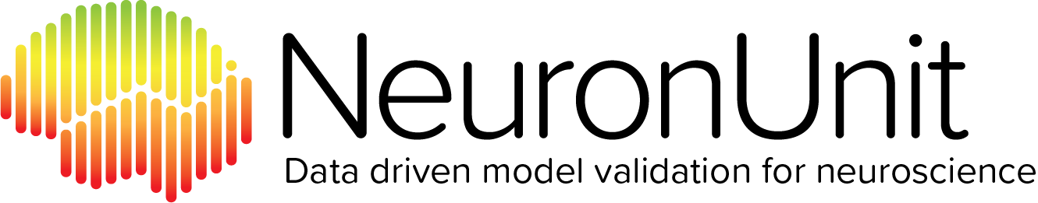
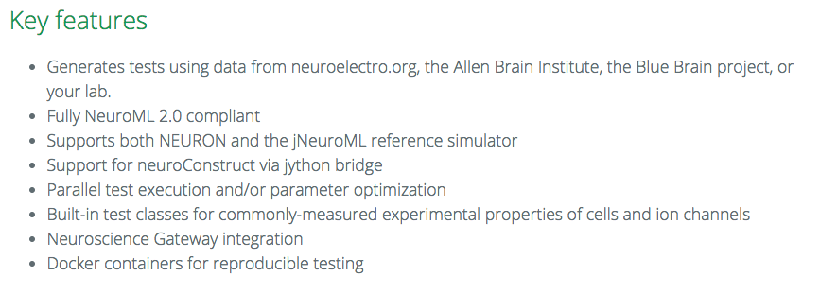

Slide 38


Concept: Nigel Goddard, Mike Hucka, Fred Howell, Hugo Cornelis, Kavita Shankar, Dave Beeman
Early Implementation: Fred Howell, Robert Cannon
Current Form: Padraig Gleeson, Sharon Crook, Angus Silver, Fred Howell, Robert Cannon, Weihong Qi, Joseph Svitak, Boris Marin, Eugenio Piasini, Gautham Ganapathy, Michael Hines, Guy Billings, Matteo Farinella, Tom Morse, Andrew Davison, Subhasis Ray, Upi Bhalla, Simon Barnes, Yoana Dimitrova, Laszlo Laborszky, Zoltan Nadasdy, Sushil Kambampati, Nicola McDonnell, Volker Steuber, Dave Beeman, Mike Hucka, Hugo Cornelis, Lyle Graham, Giorgio Ascoli, Sandra Berger, Avrama Blackwell, Sean Hill, Nicolas Le Novere, Nathan Lepora, Michele Mattioni, Henrik Linden, Arnd Roth, Koen Vervaeke, Murat Alp, Ted Carnevale, Suzanne Dietrich, Joe Graham, Marco Herrera-Valdez, Stephen Larson, Michele Mattioni, Alfredo Rodriguez, Dieter Jaeger, Cengiz Gunay, Sergio Solinas, Roger Traub, Andrew Brown, Dave Lester, Paul Richmond, Matteo Cantarelli, Giovanni Idili, Sathyaa Subramaniyam, Mike Hull, Richard Tomsett, James Kozloski, Eilif Muller, Sarah Keating, Nicolas Rodriguez, Maria Schilstra
NeuroML Editorial Board
Special Acknowledgements
NeuroML: Angus Silver, Padraig Gleeson, and over 60 contributors
NeuroML Editors: Upi Bhalla, Andrew Davison, Padraig Gleeson, Boris Marin, Robert McDougal
NeuroML Database: Suzanne Dietrich, Justas Birgiolas
Model Validation: Rick Gerkin, Justas Birgiolas, Russell Jarvis
National Science Foundation &
National Institutes of Health NIMH, NIBIB

Slide 39
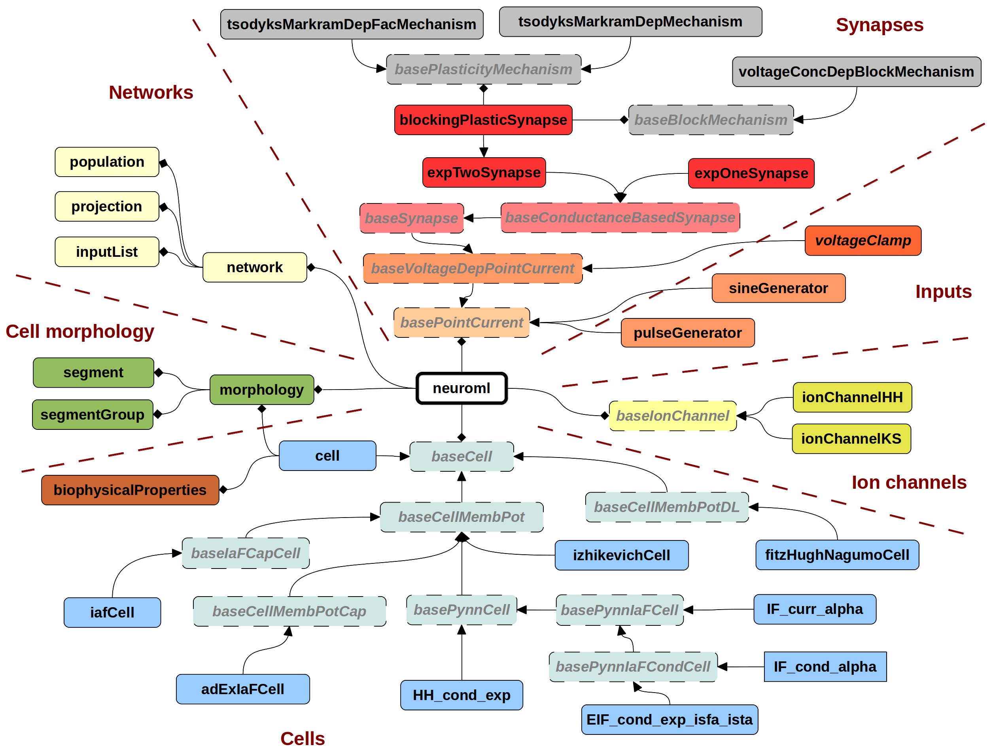
NeuroML version 2.0
http://www.opensourcebrain.org
Notes:
10/27/17
39
39

